Slide 1
Data Streaming Using Apache Kafka
Mohammed AbuAisha

Slide 2
Contents
What is Apache Kafka ?
Apache Kafka Key Concepts
Apache Kafka Topic
Kafka Replication
Data Streaming Project
Demo

Slide 3

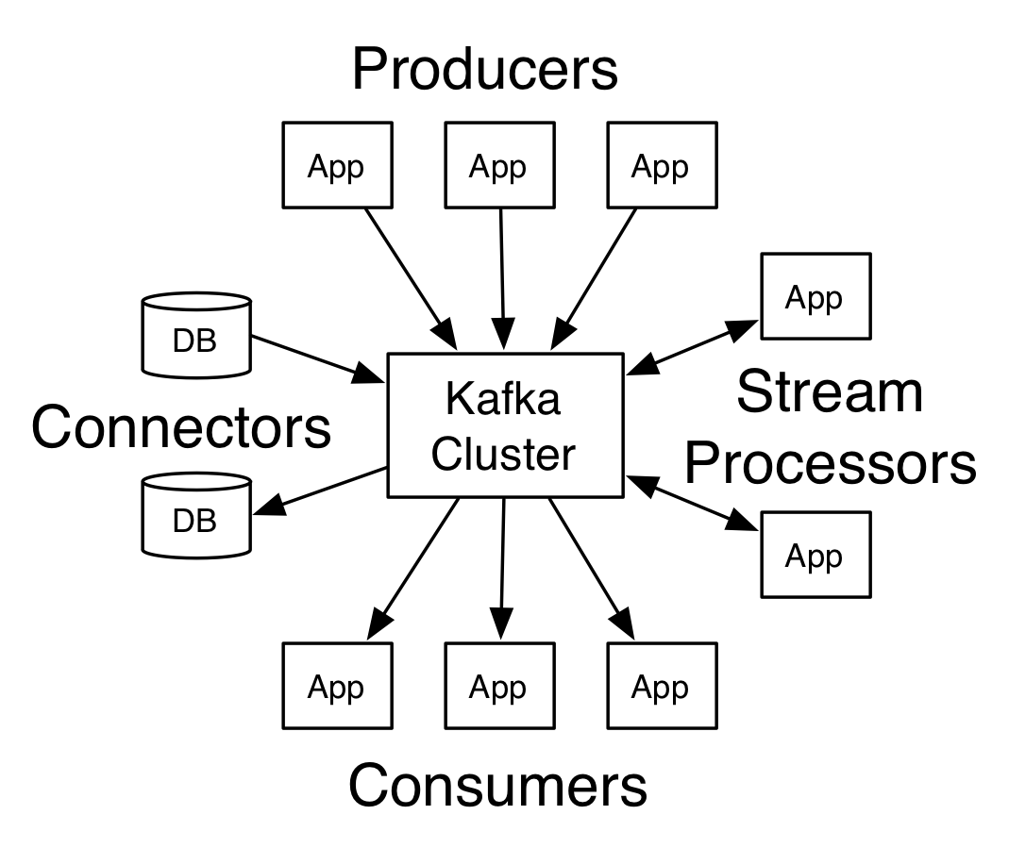
What Is Apache Kafka ?
Distributed messaging systems
Real-time
Scalable to handle large data volume
Low Latency
Fault tolerant
Originated at LinkedIn
Aimed at solving data movement across systems
Scala and Java
Open Source (Apache 2.0)
Adapted at many companies

Slide 4
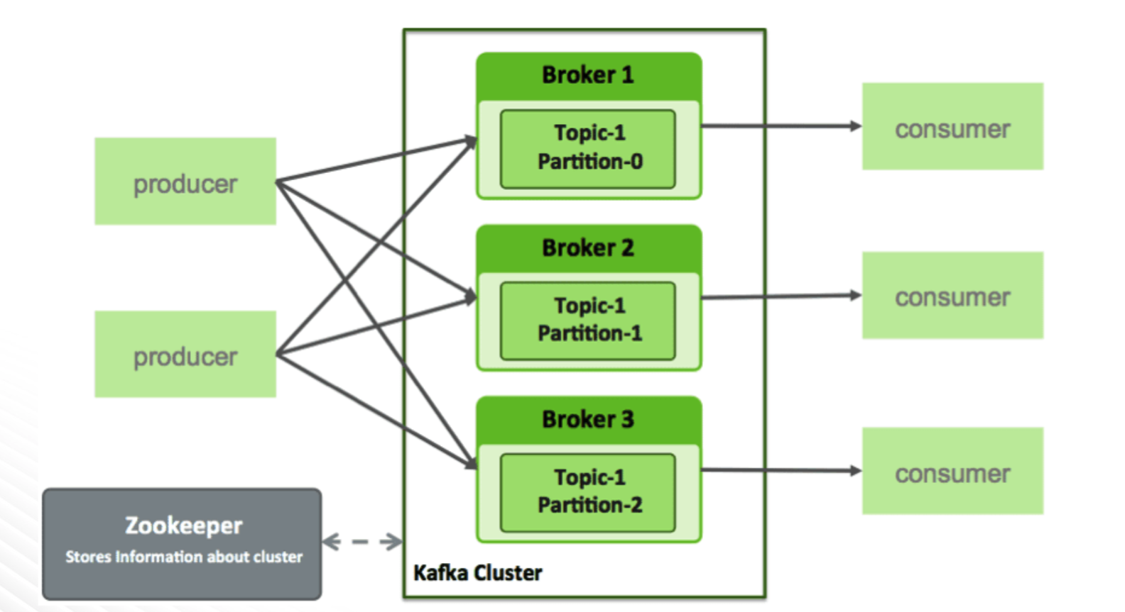
Apache Kafka Key Concepts

Slide 5
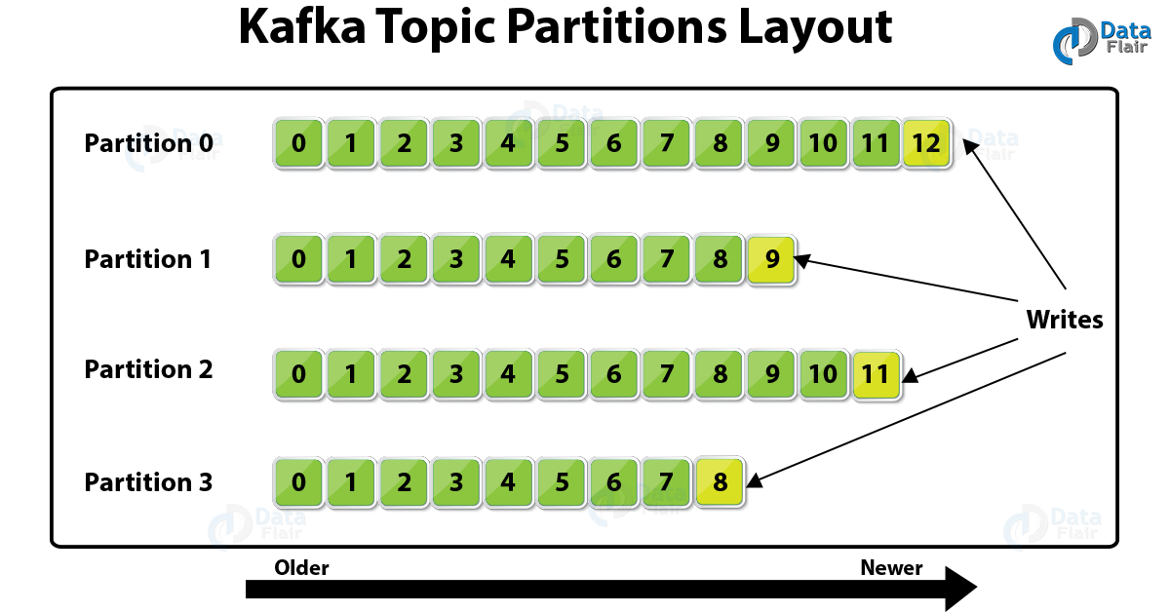
Apache Kafka Topics
Messages (logs) are stored on broker’s local disk
Messages are appended to log file
Log Retention – time and size based

Slide 6
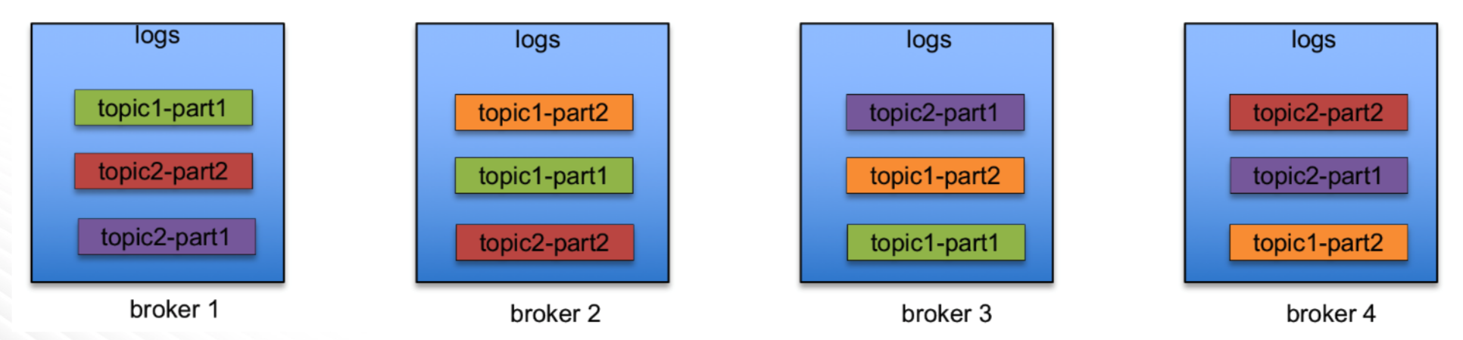
Apache Kafka Replication
Partition has replicas – Leader replica, Follower replicas
Replicas are distributed to multiple brokers
Leader maintains in-sync-replicas (ISR)

Slide 7
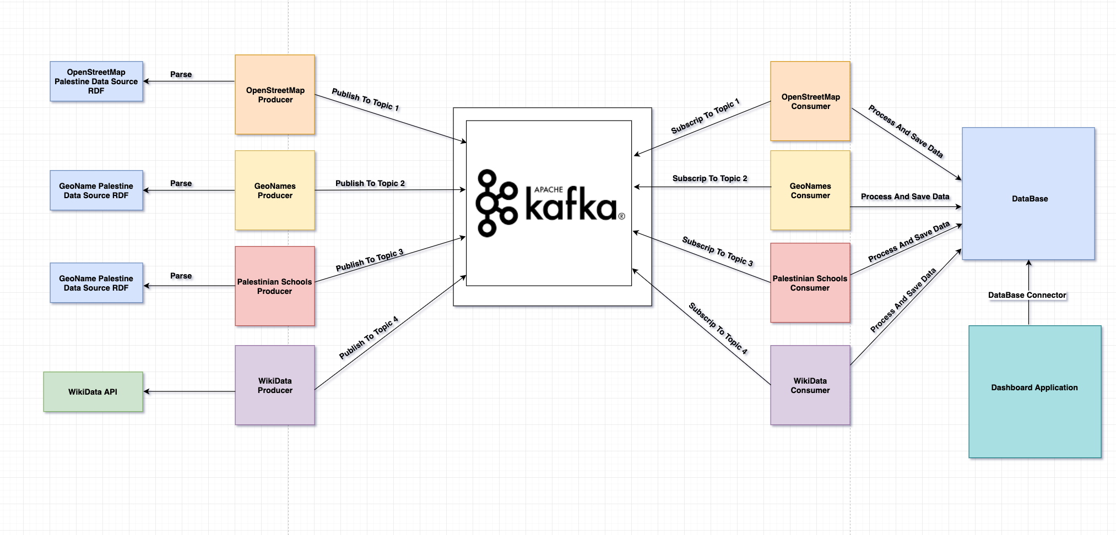
Data Streaming Project

Slide 8
Data Streaming Project
Kafka Cluster
Topics
Brokers
4 Producers (Python)
4 Consumers (Python)
DataBase
Python Application DashBoard

Slide 9
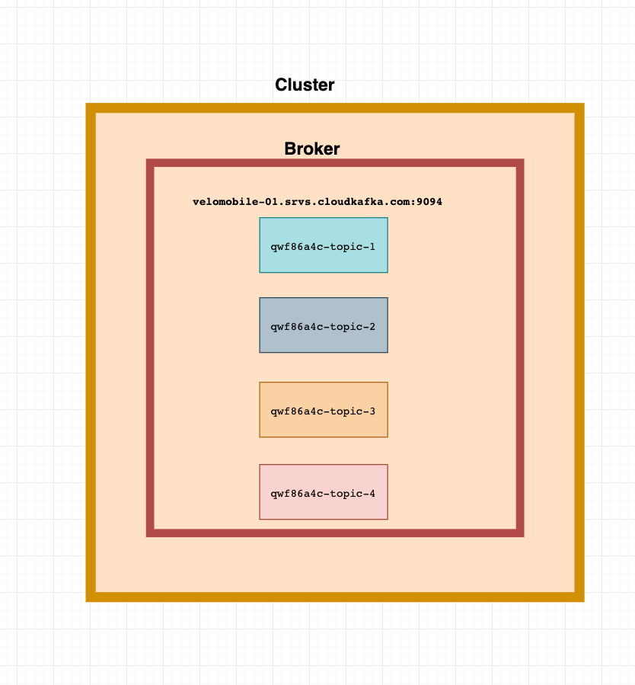
Data Streaming Project
Kafka Cluster
4 topics
Topic-1: OpenstreetMap Data Streams
Topic-2: GeoNames Data Streams
Topic-3: Schools Data Streams
Topic-4: WikiData Stream
1 Broker Server

Slide 10
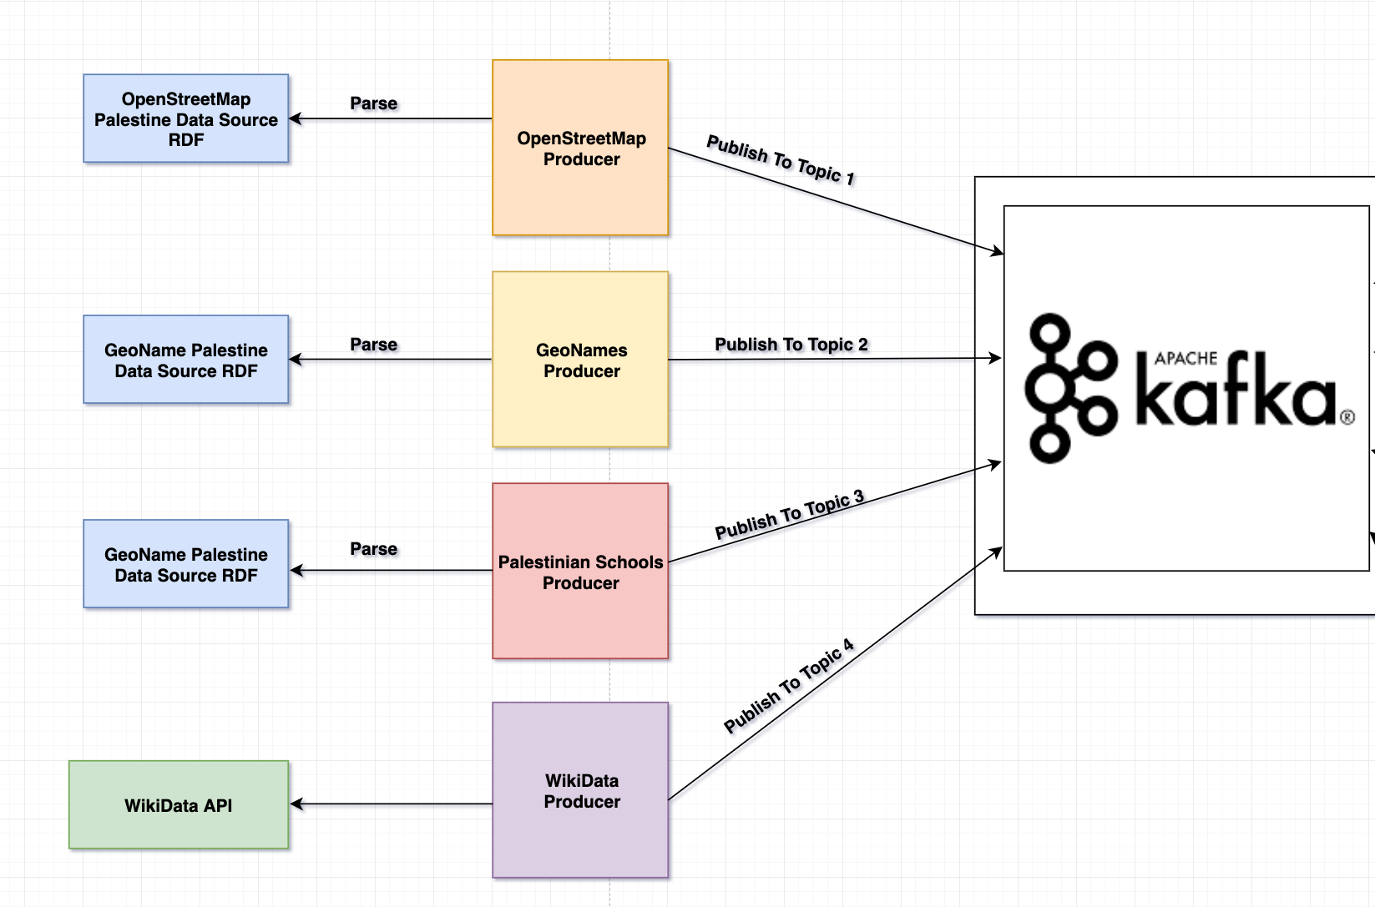
Data Streaming Project
Python Producers
OpenStreetMap Producer
GeoName Producer
Schools Producer
WikiData Producer

Slide 11
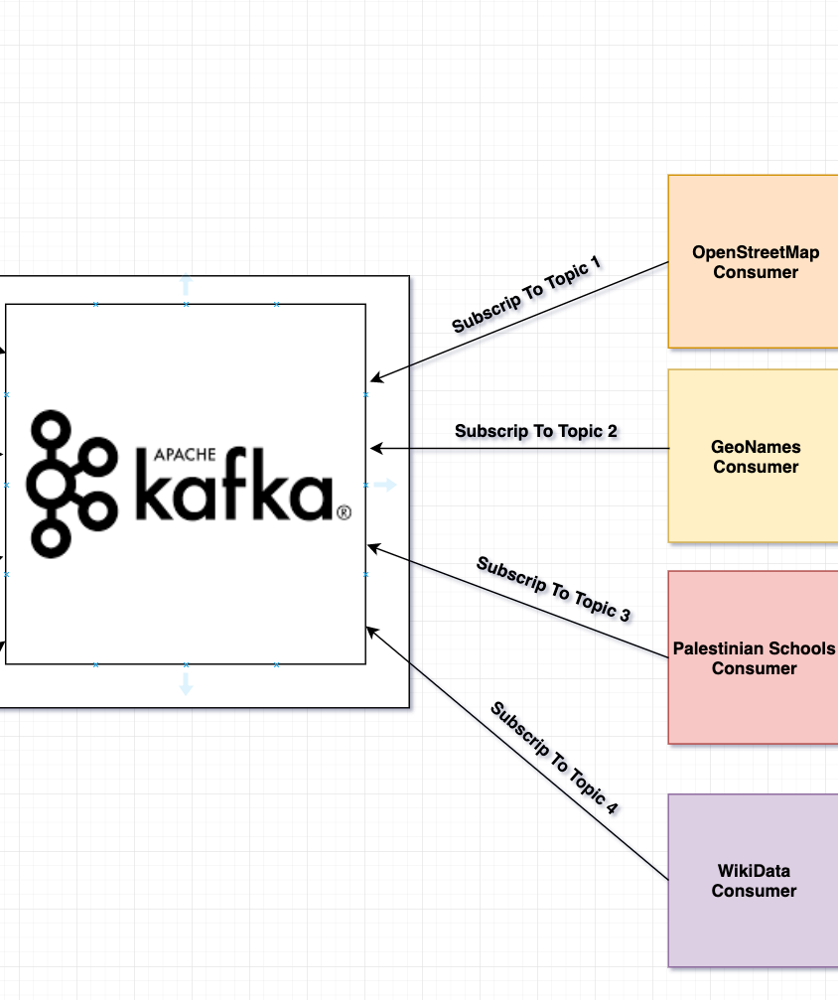
Data Streaming Project
Python Consumers
OpenStreetMap Consumer
GeoName Consumer
Schools Consumer
WikiData Consumer

Slide 12
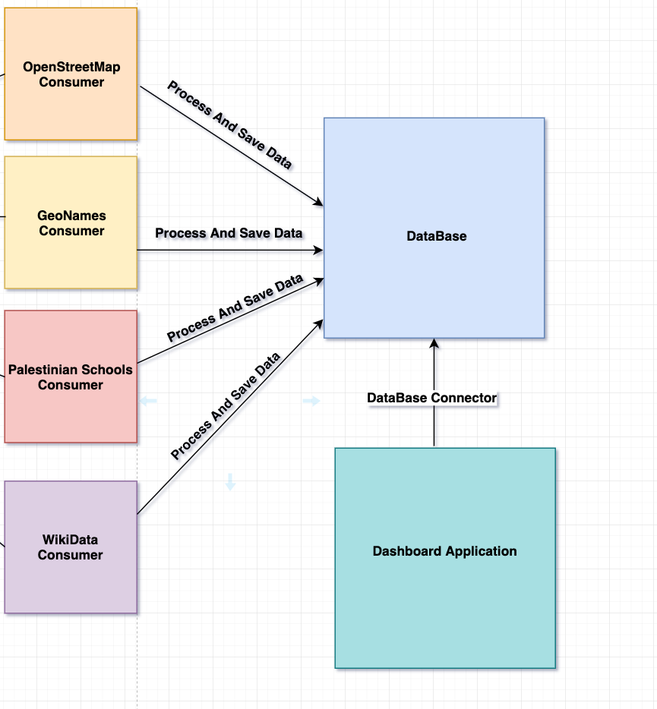
Data Streaming Project
Database Sync Data From All Consumers

Slide 13
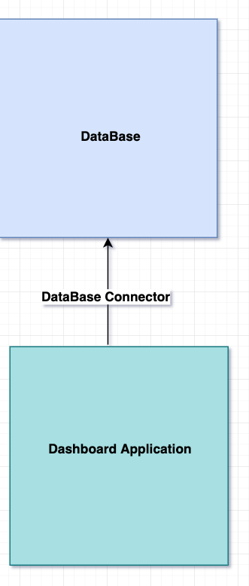
Data Streaming Project
Python DashBoard Application

Slide 14




Data Streaming Project
Programming Languages
Python 3.7.0
Web FrameWork
Django 2.1.2
DataBase
SQLite DataBase
Kafka Cluster
Cloudkarafka Cloud Service

Slide 15
Demo

